Slide 1
Applied Studies - Computer Graphics
Year 9 and/or 10

Slide 2
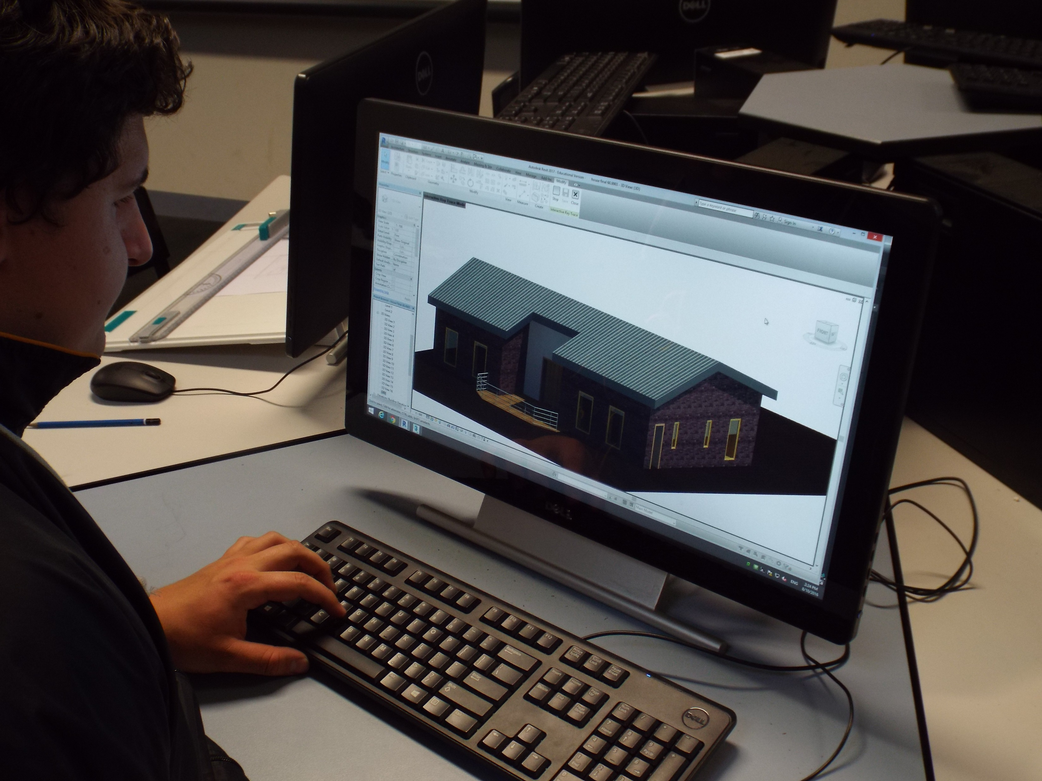
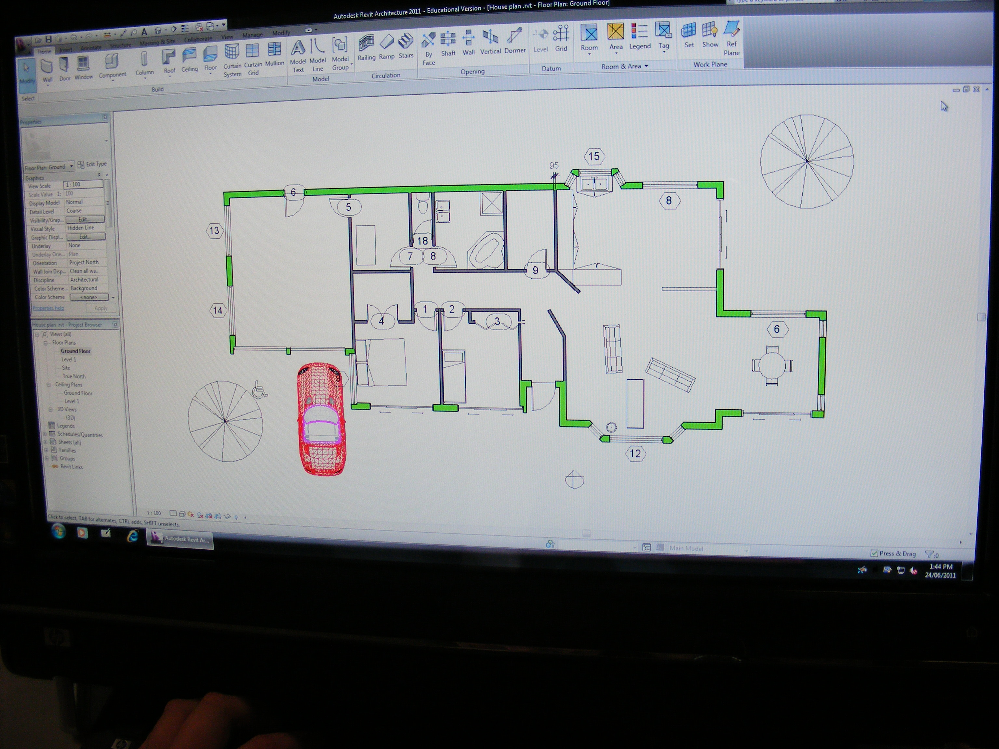
Computer Graphics
1 or 2 year course
Prepares students for a pathway in Graphic Design
Supports the design aspect of practical subjects like Design in Wood, Design in Metal, Intro to Construction (VET) and Intro to Engineering Pathways (VET)
Includes drawing techniques as well as computer aided design
Students can negotiate individual projects in their areas of interest

Slide 3
Find out more…
Please feel free to contact Mrs Selina Kinne, Head of Technology and Applied Studies, at skinne@dominic.tas.edu.au

